Slide 1
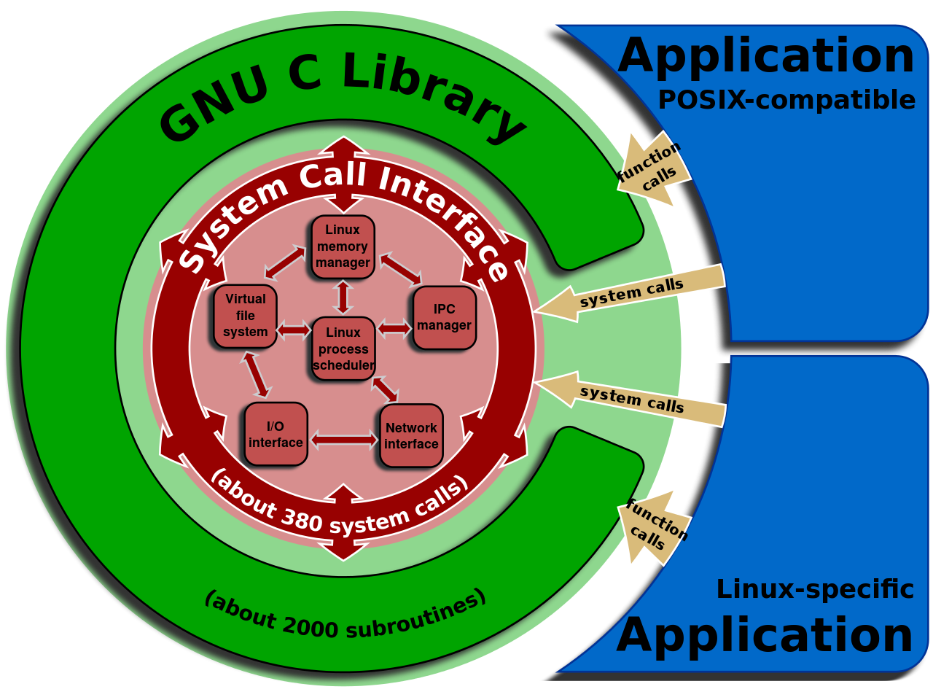
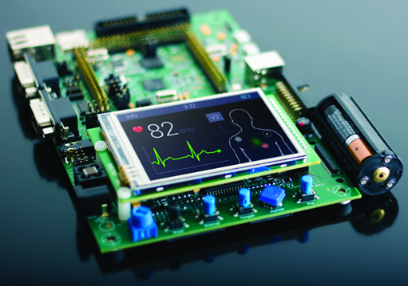
Computer Systems and Programming (CS367)
Prof. Kevin Andrea
Image: https://olayiwolaayinde.medium.com/why-learn-embedded-systems-87bbf5aafd04
Image: By Shmuel Csaba Otto Traian, CC BY-SA 3.0, https://commons.wikimedia.org/w/index.php?curid=31368855
Notes:
Title Slide

Slide 2
Course Overview
CS367 is an Introduction to a field of CS called Systems Programming
Systems Programming – Programming services to other software.
Game Engines
Operating Systems
Embedded Systems
Industrial Automation
Networking
Optimizing and Reverse Engineering Code
This prepares you for CS471 (Operating Systems) and other systems courses.

Slide 3
Course Goals – Removing Abstractions
Most CS Courses Focus on Abstractions
Abstract Data Types (e.g. Interfaces in Java)
Asymptotic Analysis (Big-Oh)
Abstractions only go so far...
In systems, it’s important to understand the underlying implementations.
Especially in the presence of bugs!

Slide 4
Course Goals – Outcomes
Outcomes for CS 367
Become more effective programmers.
Knowledge and Tools to find and eliminate bugs efficiently
Able to Optimize and Tune program performance.
Prepare for later Systems Programming courses in CS, such as...
CS 440 Compilers
CS 455 Networking
CS 465 Architecture
CS 468 Secure Programming
CS 469 Security Engineering
CS 471 Operating Systems
CS 475 Concurrent and Distributed Systems

Slide 5
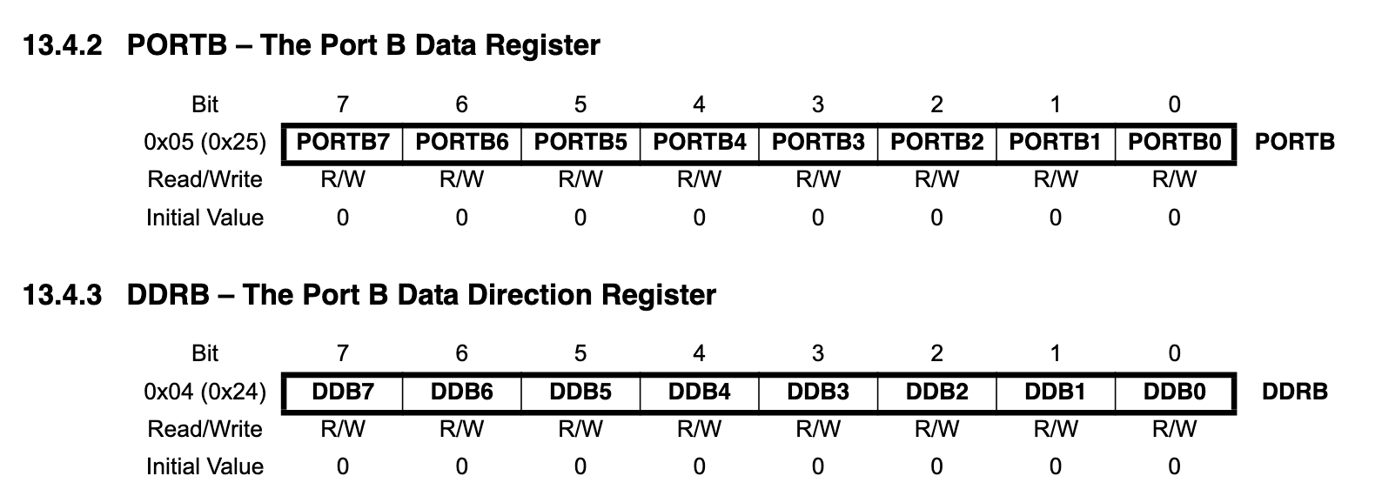
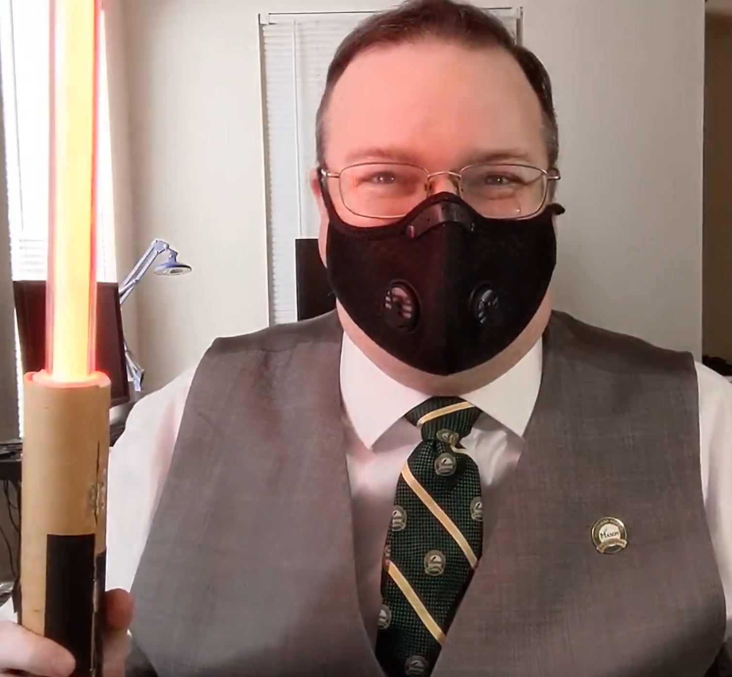
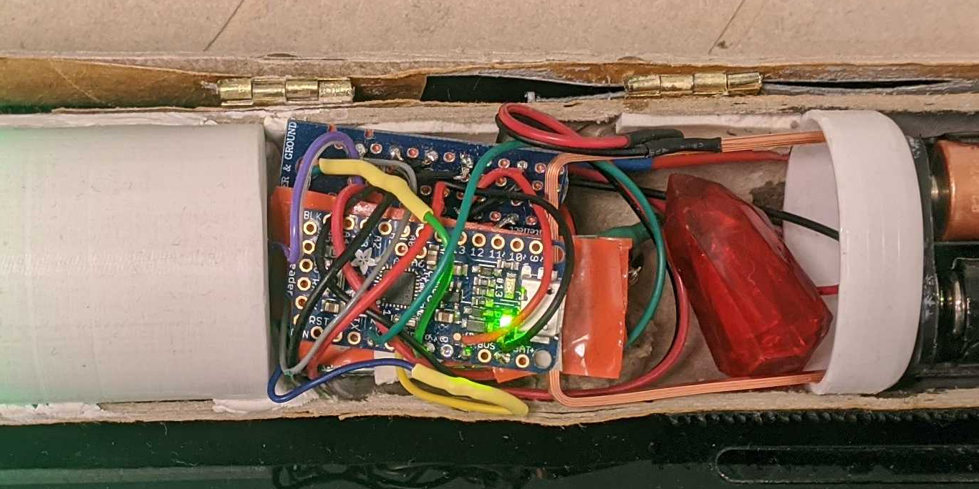

Course Goals – Outcomes
Outcomes for CS 367
Learn Foundational Experience for Industry
Embedded/Systems Programming:
Data Representation, Assembly, Memory Management, Linker/Compiler Optimizations
Cyber Security
Data Representation, Assembly, Reverse Engineering, Memory Management
if(power == HIGH) {
*p_portb |= 0x01; // Set bit0
} else {
*p_portb &= ~0x01;// Clear bit0

Slide 6
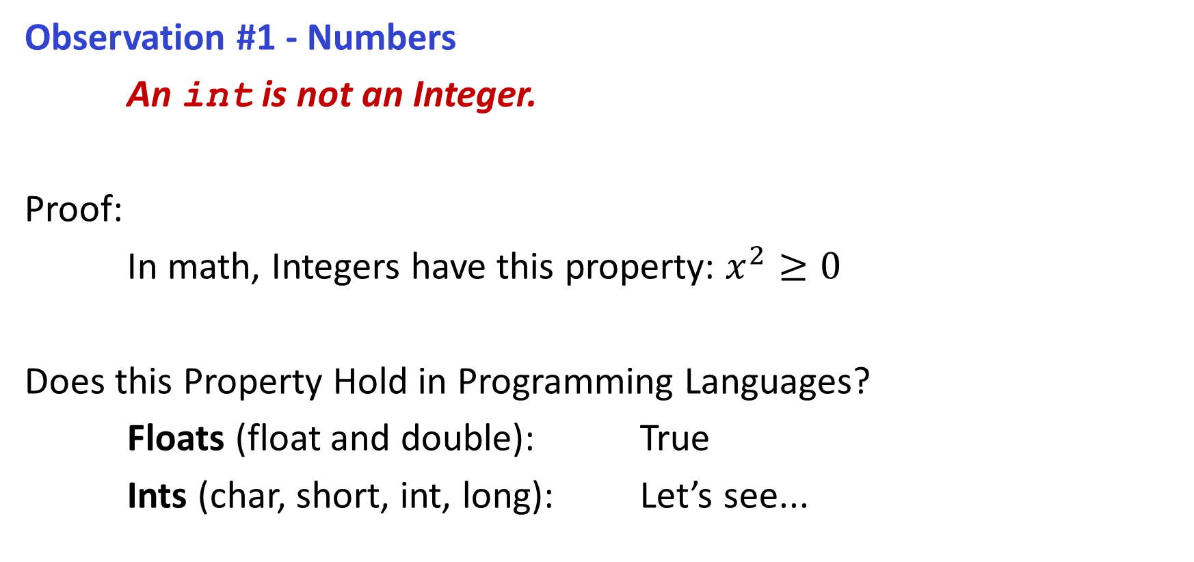
Great Realities in Programming...
int_of.c
Observation #1 - Numbers
An int is not an Integer.
Proof:
In math, Integers have this property: $x^{2}≥0$
Does this Property Hold in Programming Languages?
Floats (float and double): True
Ints (char, short, int, long): Let’s see...

Slide 7
Great Realities in Programming...
An int is not an Integer.
Can this cause any problems if we don’t take it into account?
CoreGraphics (iOS and macOS) - https://support.apple.com/en-ca/HT212807
Impact: Processing a maliciously crafted PDF may lead to arbitrary code execution.
Description: An integer overflow was addressed with improved input validation.
libstagefright (Android) - https://cve.mitre.org/cgi-bin/cvename.cgi?name=CVE-2015-1538
Impact: Allows remote attackers to execute arbitrary code via crafted atoms in MP4 data
Description: Integer overflow in the SampleTable::setSampleToChunkParams function
BatchOverflow (Ethereum) - https://cryptoslate.com/batchoverflow-exploit-creates-trillions-of-ethereum-tokens/ Impact: $115∗{10}^{57}$(115 octodecillion) BEC coins were created in two transactions. (about $ $3.7∗{10}^{60}$)
Description: Integer overflow used to bypass ‘sanity’ checks that prevent transferring with a zero balance.
Boeing 787 - https://arstechnica.com/information-technology/2015/05/boeing-787-dreamliners-contain-a-potentially-catastrophic-software-bug/
Impact: Failure of Electrical System and Loss of Control of the Aircraft.
Description: Integer overflow after 248 days of power causes generator control units to failsafe.

Slide 8
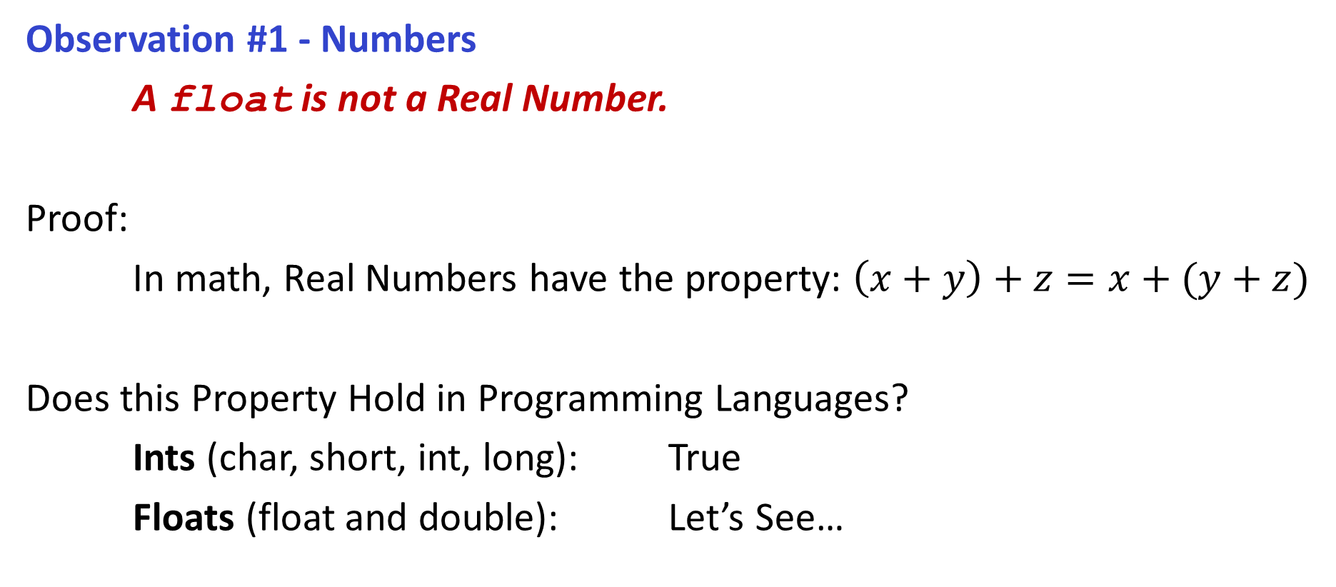
Great Realities in Programming...
fp_of.c
Observation #1 - Numbers
A float is not a Real Number.
Proof:
In math, Real Numbers have the property: $\left(x+y\right)+z=x+(y+z)$
Does this Property Hold in Programming Languages?
Ints (char, short, int, long): True
Floats (float and double): Let’s See…

Slide 9
Great Realities in Programming...
A float is not a Real Number (and Rounding errors)
Can this cause any problems if we don’t take it into account?
Ariane 5 (Rocket) - https://itsfoss.com/a-floating-point-error-that-caused-a-damage-worth-half-a-billion/
Impact: Loss of a half-billion-dollar Rocket.
Description: Conversion from a Float to an Int led to an Integer Overflow and the motors overcorrected.
Patriot Missile (US Defense) - http://nifty.stanford.edu/2003/pests/2002/lectures/07.1_FloatingPoint/Patriot.html Impact: The defense missile missed the incoming rocket by 600m and many lives were lost.
Description: Conversion from Integer to Float increases in inaccuracy the larger the Integers are.
Vancouver Stock Exchange - https://www5.in.tum.de/~huckle/Vancouv.pdf
Impact: An index was reporting at half its true value.
Description: Floating Point Truncation instead of Rounding led to Cumulative Decrease in Value

Slide 10
Computer Arithmetic
CPU Arithmetic Logic Units (ALUs) do not generate random values!
Arithmetic operations have important mathematical properties
We cannot assume ‘usual’ math properties apply for computers!
There are a finite number of bits to represent each number
Knowing how each number type conforms to math is important:
Integers Follow Commutativity, Associativity, and Distributivity
Floating Point Follow Monotonicity and Values of Signs

Slide 11
Fun Realities with Numbers
int_index.c
So, knowing these properties, we can have some fun with math.
Demo 1: Let’s look at the following program...
// Iterate through values using an int
int main() {
int index = 0; // Integer-based index for a for-loop.
// Iterate through index values until index is negative.
for(index = 0; index >= 0; index++) {
print_dot(DOT_FREQUENCY); // Print a '.' every DOT_FREQUENCY calls
}
printf("\nMath Broke when index overflowed to %d\n", index);
return EXIT_SUCCESS; // Returns a successful code. (0)
}

Slide 12
Fun Realities with Numbers
fp_index_a.c
So, knowing these properties, we can have some fun with math.
Demo 2: What about this one, will it ever terminate?
float index = 0; // Floating-Point based index for a for-loop.
// Iterate through index values until index is negative.
for(index = 0; index >= 0; index++) {
print_dot(PRINT_FREQUENCY); // Print a '.' every PRINT_FREQUENCY calls
}
printf("\nMath Broke when index overflowed to %.2f\n", index);

Slide 13
Fun Realities with Numbers
fp_index_b.c
So, knowing these properties, we can have some fun with math.
Demo 3: Let’s look at the values for each . and just make sure it’s counting
float index = 0; // Floating-Point based index for a for-loop.
// Iterate through index values until index is negative.
for(index = 0; index >= 0; index++) {
print_dot(PRINT_FREQUENCY); // Print a '.' every PRINT_FREQUENCY calls
}
printf("\nMath Broke when index overflowed to %.2f\n", index);
kandrea@zeus$ ./fp_index_b
Let's count until math breaks!
.- Value is 0.00
.- Value is 16777216.00
.- Value is 16777216.00
.- Value is 16777216.00

Slide 14
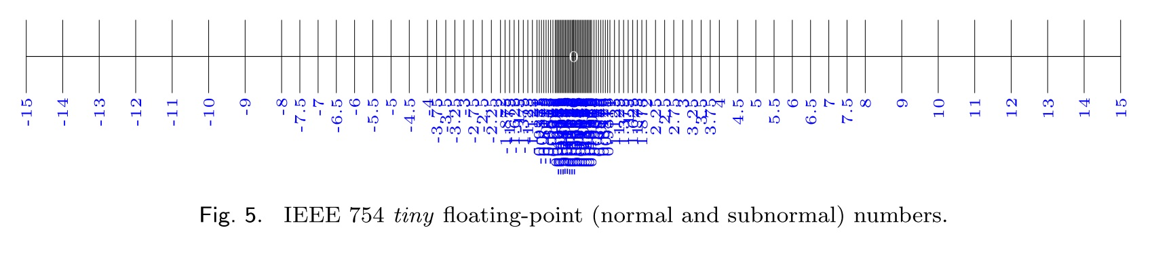
Fun Realities with Numbers
Great Realities about Floating Point Values
There are values that cannot be represented!
kandrea@zeus$ ./fp_index_b
Let's count until math breaks!
.- Value is 0.00
.- Value is 16777216.00
.- Value is 16777216.00
.- Value is 16777216.00
Showing Floating Point Representable Numbers
Image Credit: https://anniecherkaev.com/the-secret-life-of-nan

Slide 15
Great Realities in Programming...
compiler_a.c
compiler_b.c
undefined.c
Observation #2 – Assembly
It is important to know Assembly
Chances are, you may never need to write a program in Assembly
Knowing assembly is key to understanding machine-level execution
Tuning Program Performance:
Understanding what Optimizations are done / not done by the Compiler
Understanding sources of program Inefficiency
Implementing System Software:
Compilers target Machine Code (and will change your code)
Creating / Fighting Malware:
x86 Assembly is a critical language for Reverse Engineering

Slide 16
Great Realities in Programming...
Observation #3 – Memory Matters
Memory is important to really understand because...
Memory is not Unbounded
It must be allocated and managed by each Process
Many applications are memory Dominated
Memory Referencing Bugs are very Problematic
Memory Performance is not Uniform
Cache and Virtual Memory greatly affect Program Performance
Adjusting Code to better use Caching can lead to better Performance

Slide 17
Memory Referencing Bug
mem_fun.c
static void perform_memory_operation(int index) {
double pi = 3.14; // PI
int array[2] = {0,1}; // Simple int array. [0,1]
// Assign 42 to the index provided
array[index] = 42;
 | Memory (Stack)
a[5] | Saved State
a[4] | Return Address
a[3] | d[0]
a[2] | Unknown (Align)
a[1] | a[1]
a[0] | a[0]
kandrea@zeus-1:cs367-overview/ (develop)$ ./mem_fun 1
Before Setting array[1] to 42...
Value of pi: 3.140000
Value of array[0]: 0
Value of array[1]: 1
After Setting array[1] to 42...
Value of pi: 3.140000
Value of array[0]: 0
Value of array[1]: 42

Slide 18
Memory Referencing Bug
mem_fun.c
static void perform_memory_operation(int index) {
double pi = 3.14; // PI
int array[2] = {0,1}; // Simple int array. [0,1]
// Assign 42 to the index provided
array[index] = 42;
 | Memory (Stack)
a[5] | Saved State
a[4] | Return Address
a[3] | d[0]
a[2] | Unknown (Align)
a[1] | a[1]
a[0] | a[0]
kandrea@zeus-1:cs367-overview/ (develop)$ ./mem_fun 3
Before Setting array[3] to 42...
Value of pi: 3.140000
Value of array[0]: 0
Value of array[1]: 1
After Setting array[3] to 42...
Value of pi: 0.000000
Value of array[0]: 0
Value of array[1]: 1

Slide 19
Memory Referencing Bug
mem_fun.c
static void perform_memory_operation(int index) {
double pi = 3.14; // PI
int array[2] = {0,1}; // Simple int array. [0,1]
// Assign 42 to the index provided
array[index] = 42;
 | Memory (Stack)
a[5] | Saved State
a[4] | Return Address
a[3] | d[0]
a[2] | Unknown (Align)
a[1] | a[1]
a[0] | a[0]
kandrea@zeus-1:cs367-overview/ (develop)$ ./mem_fun 4
Before Setting array[4] to 42...
Value of pi: 3.140000
Value of array[0]: 0
Value of array[1]: 1
After Setting array[4] to 42...
Value of pi: 3.140000
Value of array[0]: 0
Value of array[1]: 1
Segmentation fault (core dumped)

Slide 20
Memory Referencing Errors
C (and C++) do not provide any memory protection
Out of bounds checking for Array Indexing and References
Invalid Pointer Values
Abuses of malloc/free
This can lead to really nasty bugs
Can corrupt objects logically unrelated. (eg. a[3] = X affecting d[0])
Effects of bugs can also be observed long after generated
This can make debugging programs very difficult.

Slide 21
Great Realities in Programming...
Observation #4 – Performance is more than just Asymptotic Complexity
Big-Oh (eg. O(n) ) is important for algorithms; however ...
... those ignored constant factors do matter when implemented!
Even the exact operation count doesn’t predict performance.
Performance is also impacted by memory access, caching, paging, etc.
You must know how to optimize at multiple levels.
Have to know how programs are compiled and executed, how to measure program performance, and how to improve performance without destroying modularity and generality.

Slide 22
Memory Performance Example
array_access.c
README.md
void copy_a(int src[SIZE][SIZE], int dst[SIZE][SIZE]) {
int i, j;
for(i = 0; i < SIZE; i++) {
for(j = 0; j < SIZE; j++) {
dst[i][j] = src[i][j];
}
}
}
void copy_b(int src[SIZE][SIZE], int dst[SIZE][SIZE]) {
int i, j;
for(j = 0; j < SIZE; j++) {
for(i = 0; i < SIZE; i++) {
dst[i][j] = src[i][j];
}
}
}
for(i = 0; i < SIZE; i++) {
for(j = 0; j < SIZE; j++) {
dst[i][j] = src[i][j];
}
}
for(j = 0; j < SIZE; j++) {
for(i = 0; i < SIZE; i++) {
dst[i][j] = src[i][j];
}
}
Flat profile:
Each sample counts as 0.01 seconds.
% cumulative self self total
time seconds seconds calls ms/call ms/call name
64.60 7.75 7.75 1000 7.75 7.75 copy_b
36.35 12.10 4.36 1000 4.36 4.36 copy_a
0.17 12.12 0.02 main

Slide 23
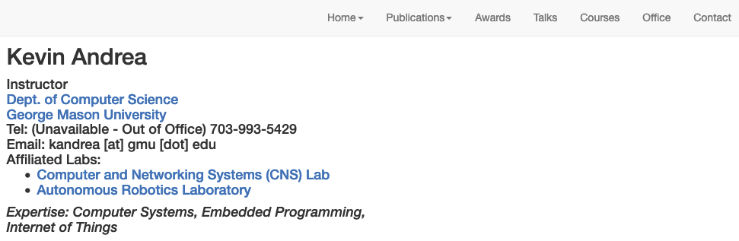
Contact Information
Webpage : https://cs.gmu.edu/~kandrea/
Email: kandrea @ gmu . edu. Checked Daily during Working Hours. (If you haven’t received a reply in 24 hours, please send again!)

Slide 24
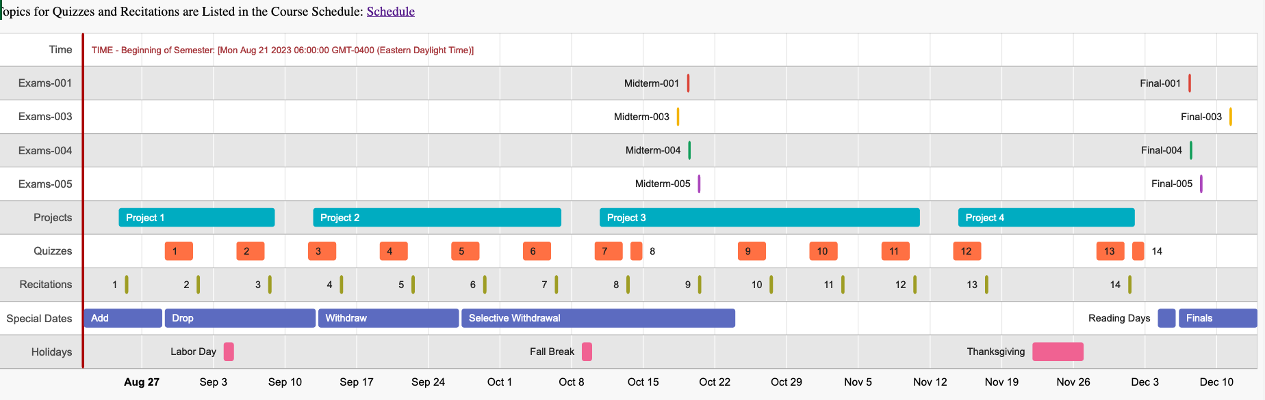
Schedule Minute
Syllabus (Available on Canvas and Piazza)
https://cs.gmu.edu/~kandrea/F24/CS367_Syllabus_F24.html
Planned Course Schedule
https://cs.gmu.edu/~kandrea/F24/CS367_Schedule_F24.html

Slide 25
Course Perspective
This Course is “Programmer-Centric”
The purpose of this course is to show how, by knowing the underlying system, you can be more effective as a programmer.
This course will enable you to:
Write Programs that are more Reliable and Efficient
Incorporate Features that tie into the OS (eg. concurrency, signals)
Use Debuggers Effectively
Reverse Engineer Programs (or a good intro to this anyways)

Slide 26
Course Prerequisites
In addition to the listed course Prerequisites, you should know how to:
Write Programs in C
C Data Types (Integer and Floating Point)
C Standard I/O Library
Bit-Level Operators (eg. ~, ^, &, |, <<, >>)
Pointers (Passing by Reference, Dereferencing)
Structures (structs and unions)
Dynamic Memory Allocation (malloc, free)
Makefiles
Compiling (gcc and its options)
Basic Debugging (gdb)
Basic Unix Commands

Slide 27
Getting Help
If you feel lost, overwhelmed, or just generally behind...
Come in to any of the office hours.
Post questions on Piazza
If the question is on the Project design or includes code, post it as private.
Email me (kandrea@gmu.edu)
I can add extra material to the next lecture to answer questions.
I can also make video supplemental lectures as time permits to answer.
Piazza is our Forum for the course. Instructions will be forthcoming.
Our Blackboard pages (Lecture and Recitation) will have all:
Slides, Recitation Assignments, and Projects

Slide 28
Lecture Style
filename.c
During Lecture we will:
Work in small groups periodically to answer some questions.
Groups work using provided whiteboards on given problems.
All Questions are provided both in Lecture Slides and on Worksheets.
Explore/Write Code
You will help me write code live and we’ll run/debug/discuss the program.
All code from slides are in the Livecode folders with the filename on the top-right.
Each Lecture may take more than a class to cover.

Slide 29
Lecture Style
After Lectures:
Recitations every Friday
Groups work to practice on new problems using the techniques we just covered.
These will be both worksheet and programming.
Midterm Sample Questions
After Friday, new sample questions will be added to the Practice Midterm
At any point, you can open the Practice Midterm and be able to do questions.
Quizzes
The following week there will be an online quiz on the last week’s material.
Supplemental Videos
These are not recorded lectures, but short videos reviewing each topic.

Slide 30
Homework
Before your next class....
Reading:
Read through Chapter 1 of the Textbook
This is a really good overview of what we’re going to be covering and why.
Review C
Next class we’ll go very quickly through a lot of C review.
We’ll cover basic operators, some basic I/O, types and structures, and we’ll end on Linked Lists.
(This are generally K&R Chapters 1, 5, 6, and 7)

